Slide 1

Welcome
to
Preparing Volunteers for Kairos Workshop

Slide 2
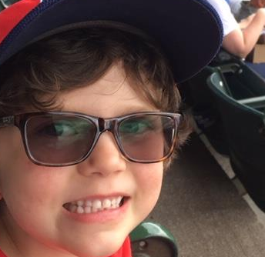
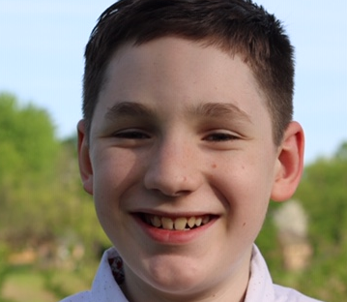
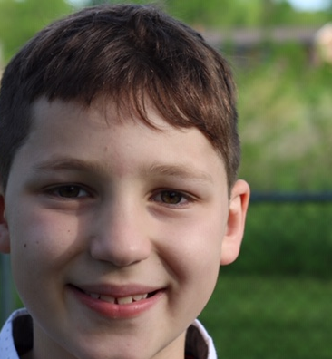
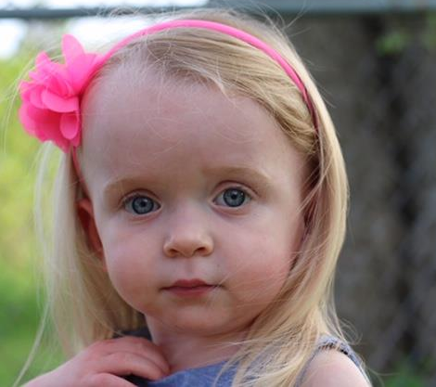

Slide 3


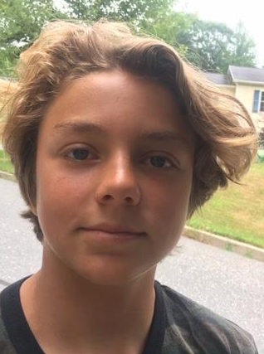
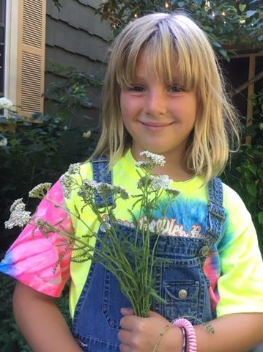
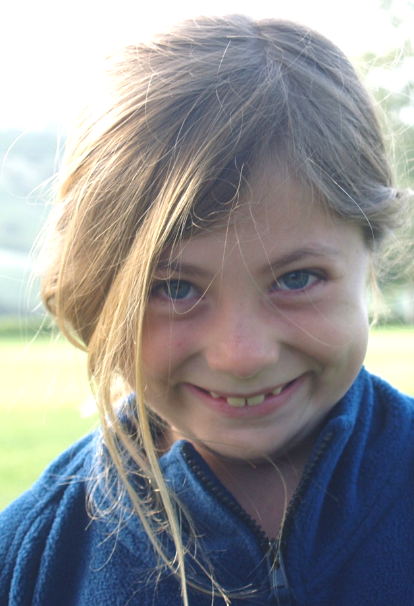
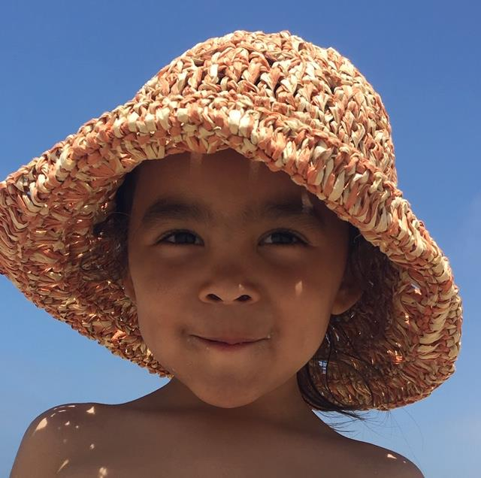
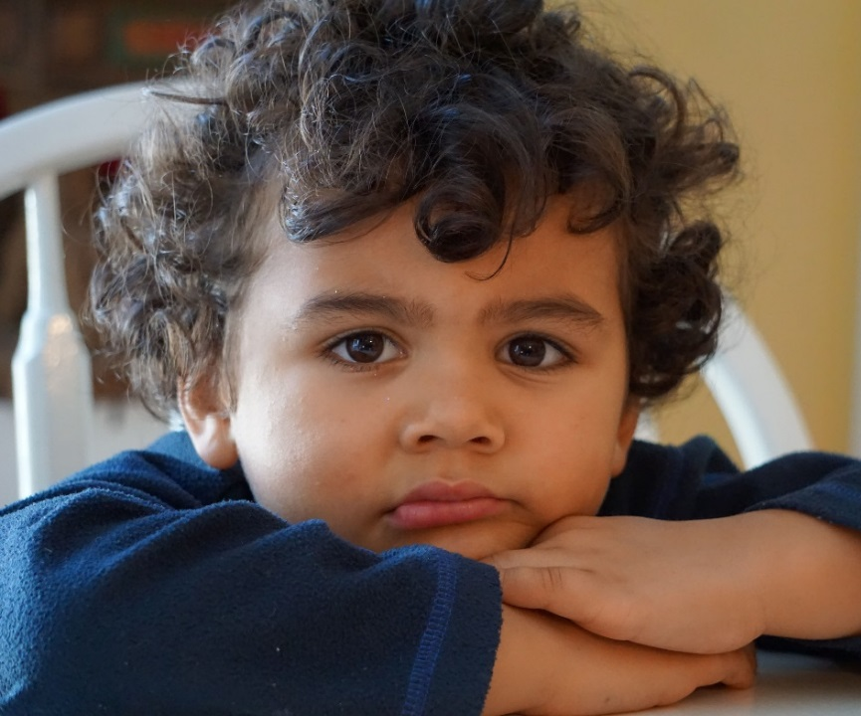

Slide 4
Kairos Leaders Prayer
&
Meditation

Slide 5
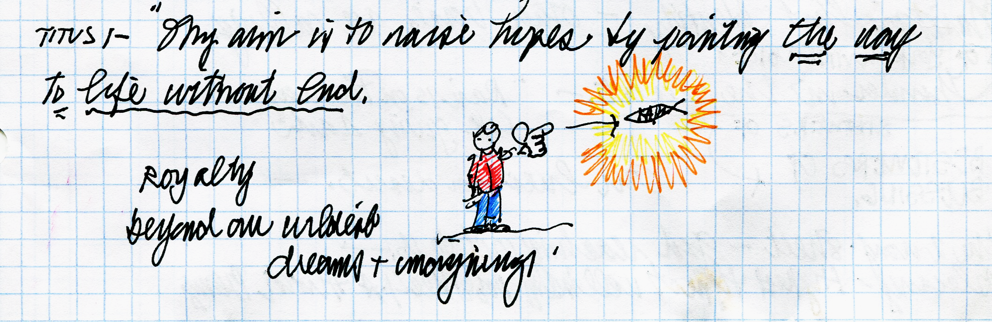
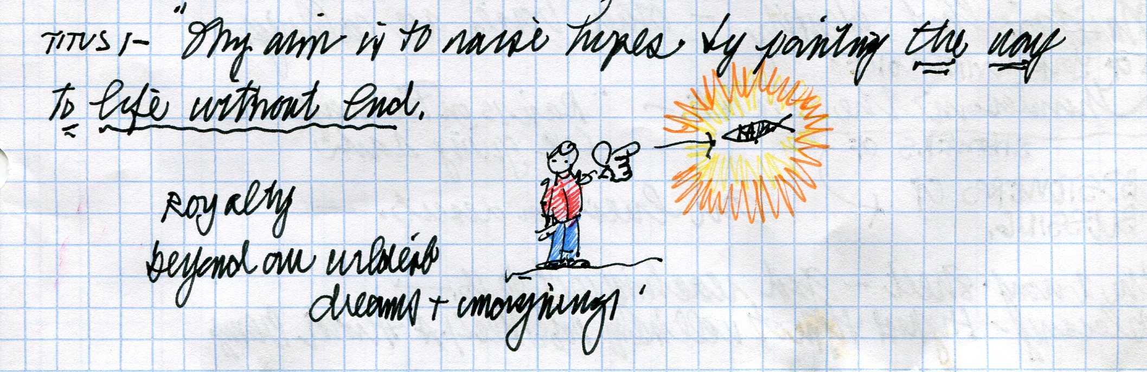
The Kairos Vision
A community
spiritually freed from the effects of imprisonment
reaching all impacted by incarceration
through the love, hope and faith
found in Jesus Christ

Slide 6
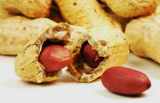
What my Father wants
(in a nutshell)
Everyone put together,
upright and whole.

Slide 7

He’s Got the
Whole Wide World

Slide 8
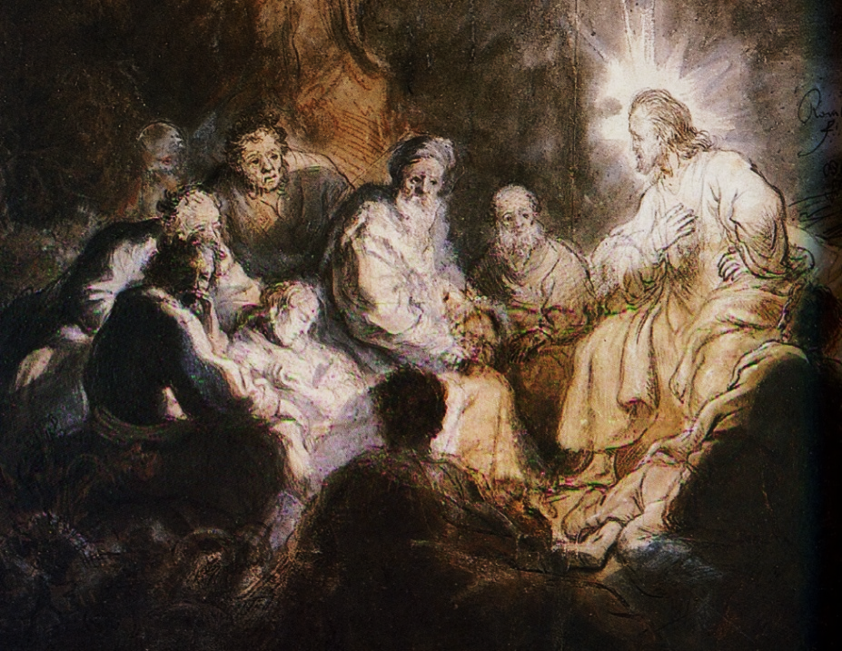
Jesus, Come join us on our journey
As we seek your will for this community in this environment…

Slide 9
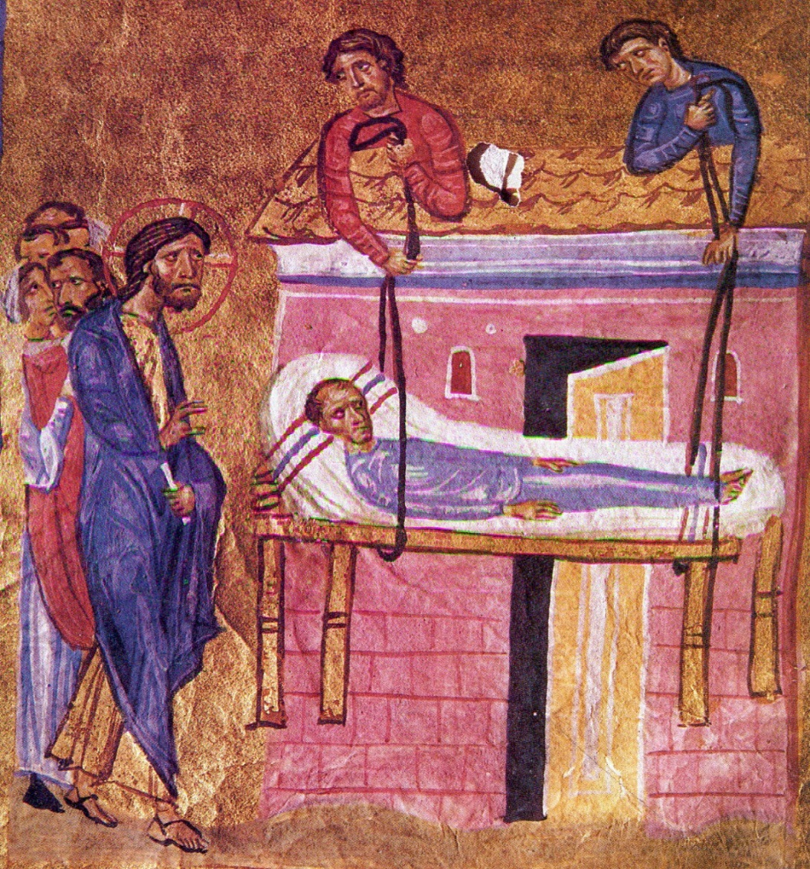

Slide 10
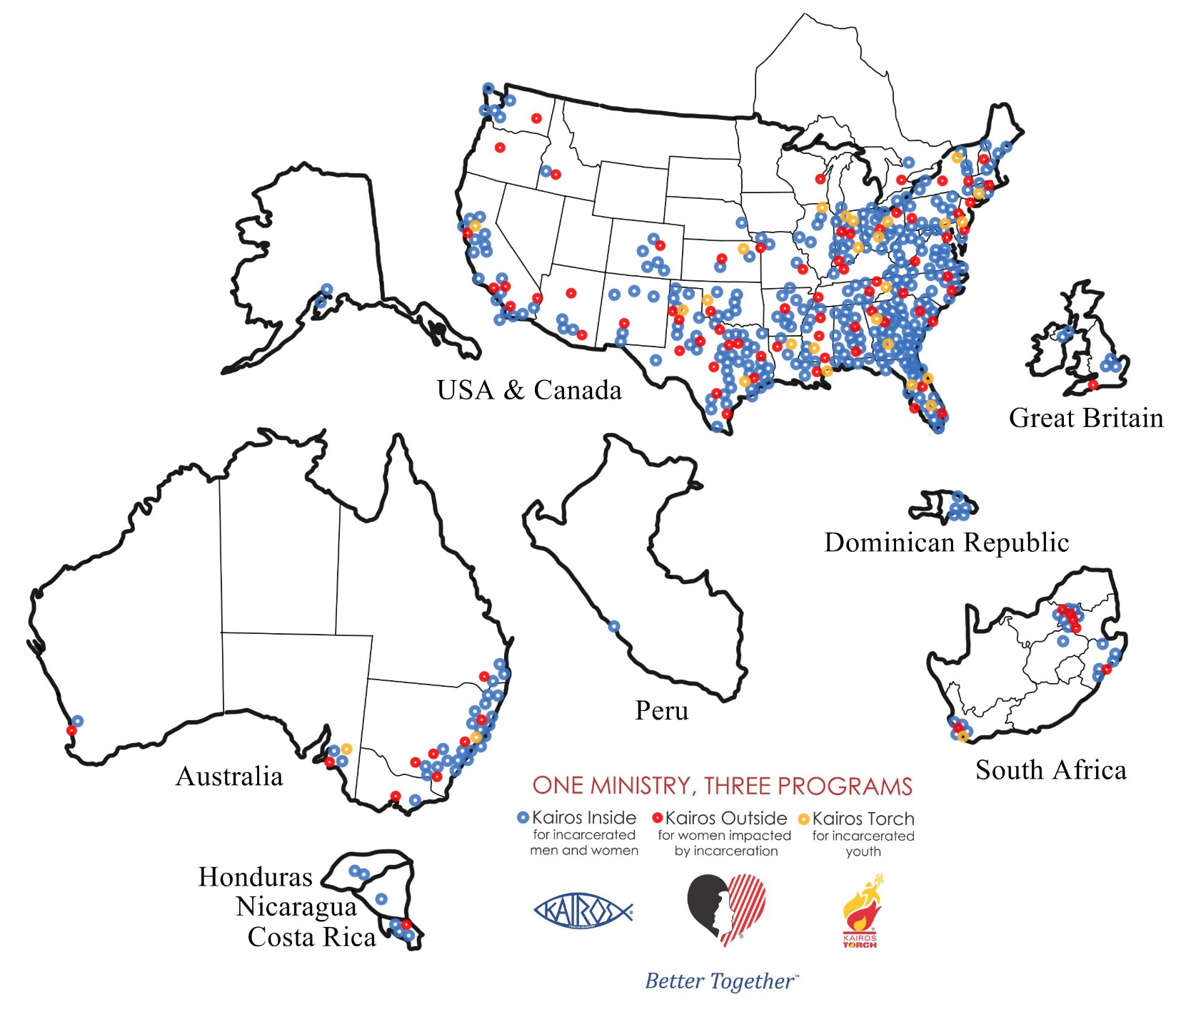
30,000 volunteers

Slide 11


A community
spiritually freed from the effects of imprisonment reaching all impacted by incarceration
through the love, hope and faith
found in Jesus Christ

Slide 12
Kairos Vision
A community spiritually freed from
the effects of imprisonment
reaching all impacted by incarceration
through the love, hope and faith
found in Jesus Christ

Slide 13
Workshop Goals
Communicate to workshop participants the importance of being “All-In” about:
Kairos Core Values & Common Ground
The Heart of Kairos Its Continuing Ministry
Supporting Kairos Volunteers
so they’ll be more effective in helping others get ready for… and be “All-In” for Kairos

Slide 14

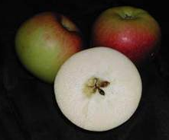
Kairos Core Values
&
Common Ground

Slide 15
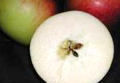
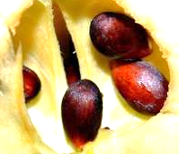
Kairos Core Values
Christ Centered.
Honest and Truthful.
Obedient to God and the guidelines of the Kairos Ministry Programs.
Lay down our private agendas.
Respect each person
Model Christ’s love
Practice Listen, Listen, Love, Love.

Slide 16


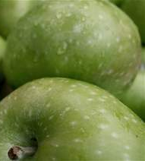


Our Kairos Identity

Slide 17

DNA - Our Kairos Identity
Friends of God
We in Kairos believe:
- the Bible is God’s authoritative and inspired word for our faith and our lives -
- in the Trinity of the Father, Son and Holy Spirit -
- in the deity, death and resurrection of Jesus Christ -
- friendship with God is a free gift, for God so loved the world that he gave His one and only Son so that whoever believes in Him shall not perish but have eternal life -
- the love of Jesus Christ motivates His followers to provide food for the hungry, drink to the thirsty, welcome to the stranger, clothes for the naked and visits to the sick and those in prison-
- in sharing the love and forgiveness of Jesus Christ with all incarcerated individuals, their families and to those who work with them inside and outside the correctional institution.

Slide 18

Identity Gives Purpose

Slide 19
Salvation
God’s work through Jesus
whereby
we’re accepted just the way we are,
and by which we are
being made whole,
repaired from the ravages of sin
and restored to our original splendor.
Dallas Willard

Slide 20

The Heart of Kairos
Prayer & Share Group – Kairos Inside
SWAP – Kairos Outside
Mentoring – Kairos Torch

Slide 21
Preparing Volunteers
Who Are
“ALL IN”

Slide 22
The Basics
We’re “Better Together”
Foundational Documents

Slide 23

“Unlock” the Secret to
Meaningful Team Meetings
Spiritual Formation
Fellowship and Bonding
Training

Slide 24
Preparing Leaders
Leadership Track
Advanced Kairos Training (AKT)
Core Team Training

Slide 25
Supporting New Volunteers
Before the 1st Team Formation Meeting
At Team Formation Meetings
At or Between Team Formation Meetings
During the Weekend
After the Weekend

Slide 26
Questions
?

Slide 27

Closing Prayer
and

